Slide 1
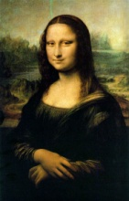
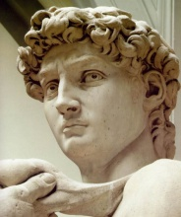
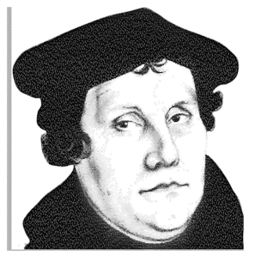
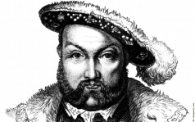
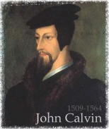
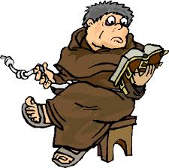
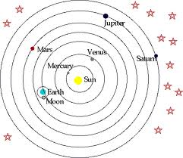
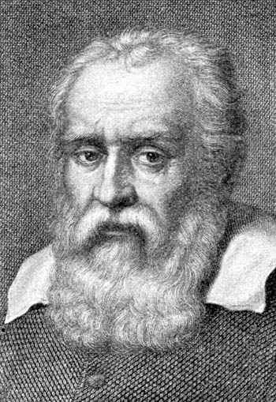
Renaissance
Causes
Characteristics
Players
Impact
s
Reformation
Germany
Switzerland
England
Counter Reformation
Impact
Scientific Revolution
Causes
Players
Impact

Slide 2
Renaissance
1350s – 1600s
Causes
Characteristics
Players
Impact
s
Humanism –
Humans have
values
Increase in Trade Creates
Wealthy Class of
Patrons
De Vinci
Raphael
Donatello
Michelangelo
Questioning Spirit
Questioning Spirit
Secular
non-religious
Machiavelli
Reformation
Renewed interest
Greece and Rome
Scientific
Revolution
Classical
Greece and Rome
Medici
Reformation
1500s -Causes –Corruption, Piety, Questioning the Church
Germany
Switzerland
England
Counter Reformation
Martin Luther
John Calvin
Henry VIII
Catholic
To little to late
95 Thesis
Indulgences
Theocracy
Geneva
Annulment
Council of Trent
Printing Revolution
Predestination
Church of England
Spanish Inquisition
Translates the Bible
Act of Supremacy
Impact
End Religious Unity
Increases the Power of the Monarchy
Scientific Revolution
1500s- 1600s
Causes
Players
Impact
Questioning Spirit
Copernicus
Increase in Trade
Galileo
Modern Science
Patrons
Descartes
Power of
Reason and Logic
Rise of the University
Bacon

Slide 3
Terms and Ideas to Know
Humanism
Classicism
Secular
Patron
Medici
Michelangelo
Leonardo Di Vinci
Raphael
Donatello
Machiavelli
Renaissance Man
Martin Luther
John Calvin
Henry VIII
Protestant Reformation
Predestination
95 Thesis
Vernacular
Galileo
Bacon
Descartes
Heliocentric
Scientific method
Indulgences
Why did the renaissance begin in Italy
How did patrons influence the renaissance.
How did humanism differ from
What civilizations were Italian renaissance artists looking to for inspiration?
What does the phrase “ends justifies the means” mean and who is credited with saying it (even though he didn’t)?
What practices of the Catholic Church did reformers like Martin Luther and John Calvin object to?
How did the protestant reformation impact the catholic Church?
How did the printing press impact the reformation?
What effects did the reformation have on Europe?
What did Bacon and Descartes agree should be used to make judgements about the world?
What is the scientific method?
Why was Galileo Galilei called before the church?

